Slide 1

NHSO DashBot
Maximize Funding Allocation & Services for Universal Coverage Scheme (UCS)
Presented By : Lorem Dimsum
Notes:
Hi everyone, we are from Lorem Dimsum Team. Our product is “NHSO Dashbot”. NHSO stands for National Health Security Office. To summarize what we do in one sentence is “we are trying to maximize funding allocation & services for universal coverage scheme.

Slide 2

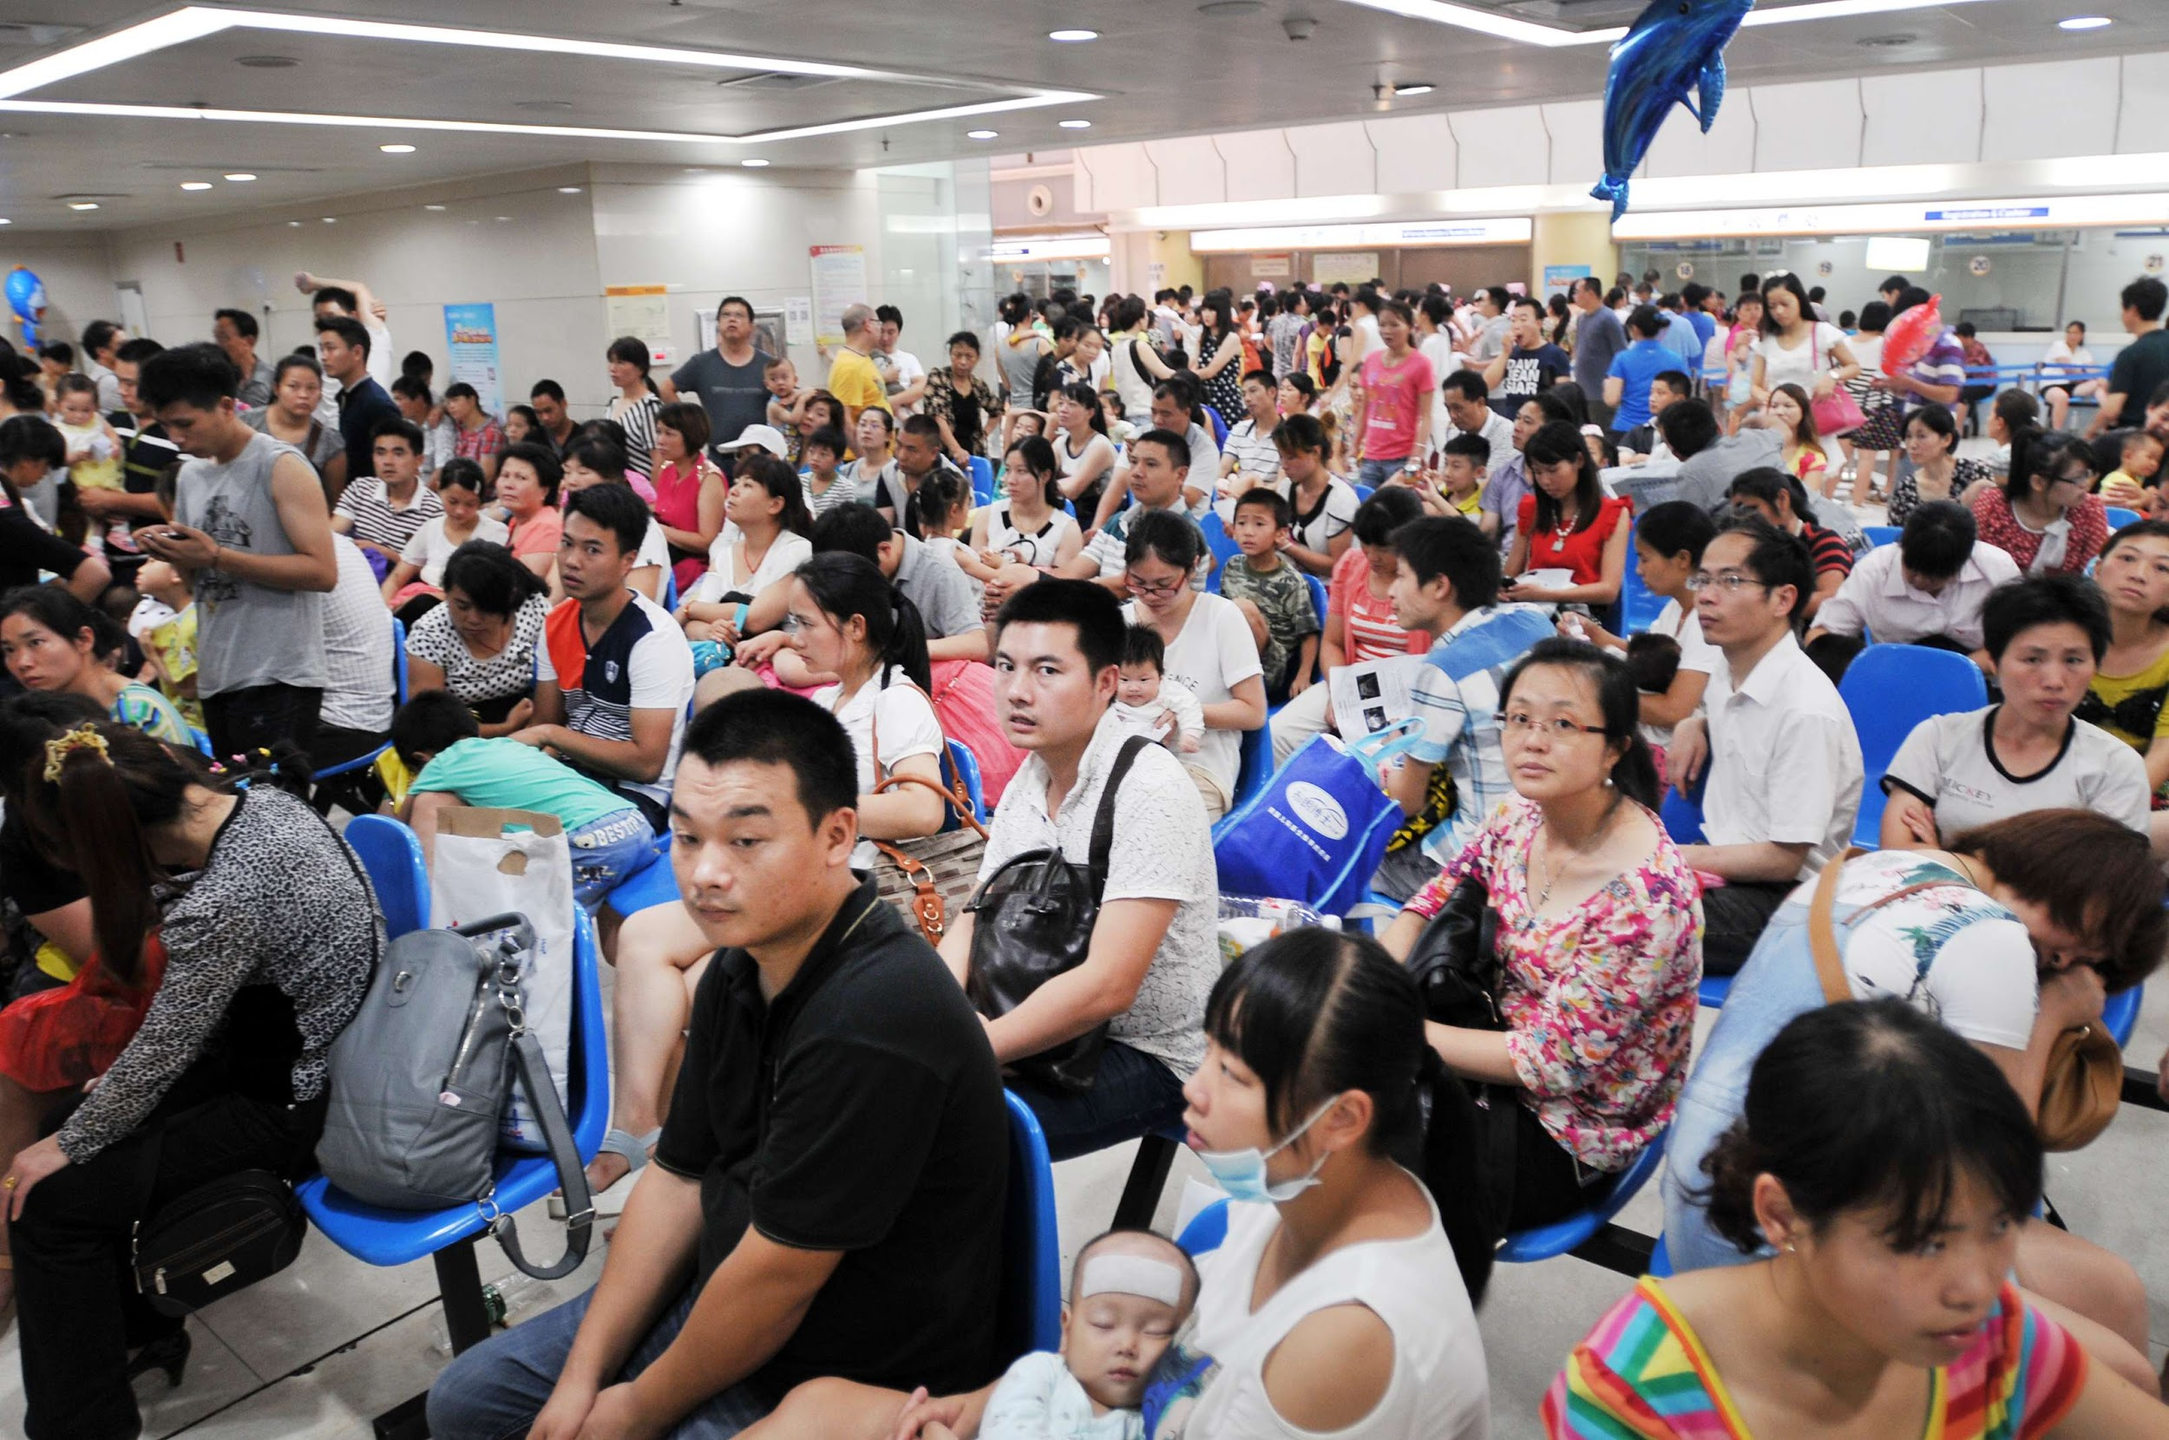
THAILAND - UNIVERSAL COVERAGE SCHEME
- National health care card for Thai citizen -
Notes:
What is Universal coverage scheme? It is a type of national healthcare system for Thai citizen. Basicly we have this yellow card and once we show this card to the hospital, most of the medication fee will be waived.

Slide 3

HEALTH MARKET OVERVIEW
163,152.18 Million THB
48.28 Million
83 Million
NHSO Budget
Registered Patients
Transactions
per year
Notes:
Let’s look at health market in Thailand, National Health Security Office budget is about 163 thousand million THB, With 48 million registered patients. And about 83 million transactions happen every year.

Slide 4

PROBLEM - GOVERNMENT
Health Data Overflow
Mismanaged Data
Poor Budget Allocation
Notes:
So, what is the problem? In term of government, with 83 millions transactions, it created health data overflow leading to mismanaged data, meaning that we don’t know how to interpret the data we have. Another problem is poor budget and resource allocation, since we don’t focus on the critical issue such as common diseases, understaffed hospital and u know, Thai resources and budget for health care is very limited.

Slide 5

PROBLEM - CITIZEN
“ What is my rights? ”
“ Where is my card? ”
“ I need help! ”
Notes:
For patient’s problem, first, some doesn’t even know what rights they have,and what does it covers because there are a number of limitation here. Second, You arrived at the hospital but realized that u left your card at home! So u can’t receive treatment u need. Third, In case of emergency and u need help, but u don’t know who to contact and that can be fatal.

Slide 6


SOLUTION - GOVTECH
Patient demographic
Most common diseases
Fatality ratio
Peak time/hospital
Budget allocation
Dataset : nhso.go.th, data.go.th
Notes:
For our solution we perform data visualization and data analysis in order to simplify data set and make it easy to understand. We rearrange patient demographic by sex and age. Most common diseases and fatality ratio of Thai people has been discovered though this analysis. Dataset given by nhso.go.th & data.go.th.
Moreover, we provide hospital peak time so, hospital can manage their staff easily. After that, government can reallocate to be more efficient.

Slide 7
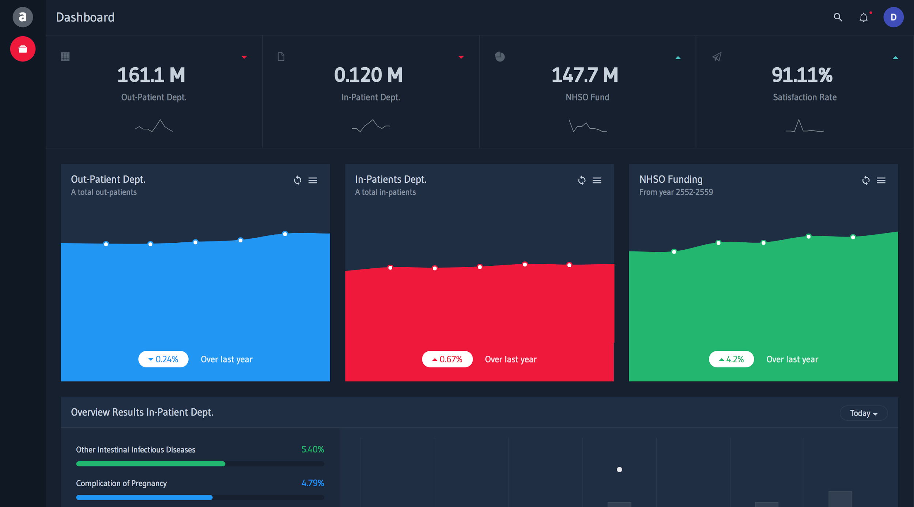
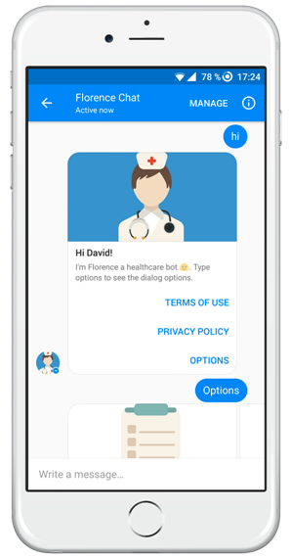
SOLUTION - CITIZEN
NHSO Dashboard
Know your own right
Medical ID & Queue
SOS iER (Location)
Notes:
This is our National Health Security Office Dashboard. We set year-to-year number of both Out-patients and In-patients. People can see NHSO funding per year and how much they spend the most for universal coverage scheme.

Slide 8
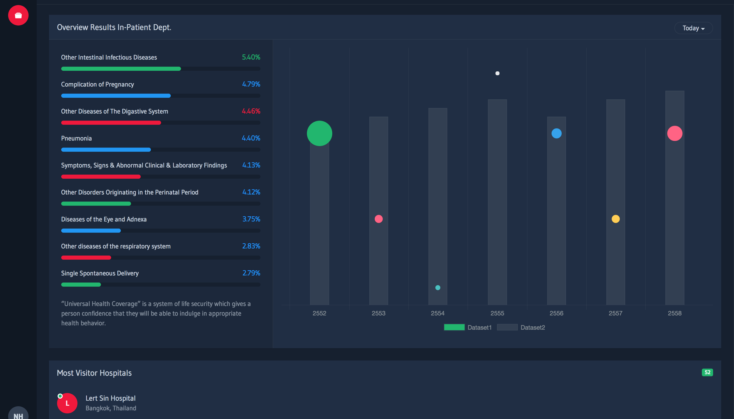
Data Visualization
Notes:
For data visualization, We use scatter plot technique to visualize the data set and find out the top most common disease for thai people using UCS. We found out that the top most common disease is about intestinal infectious disease following by complication of pregnancy.

Slide 9
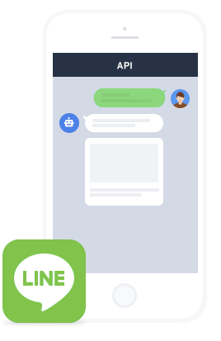
SOLUTION - CITIZEN
NHSO LINE Bot
Know your own rights
Medical ID
SOS iER (Chatbot)
Notes:
For user, they can check their UCS manual Medical ID. at anytime they want though our chatbot.

Slide 10

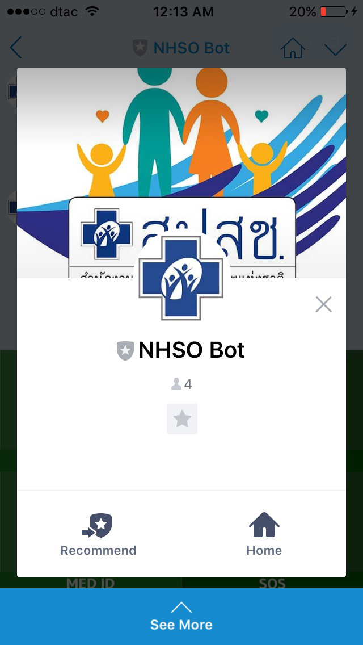
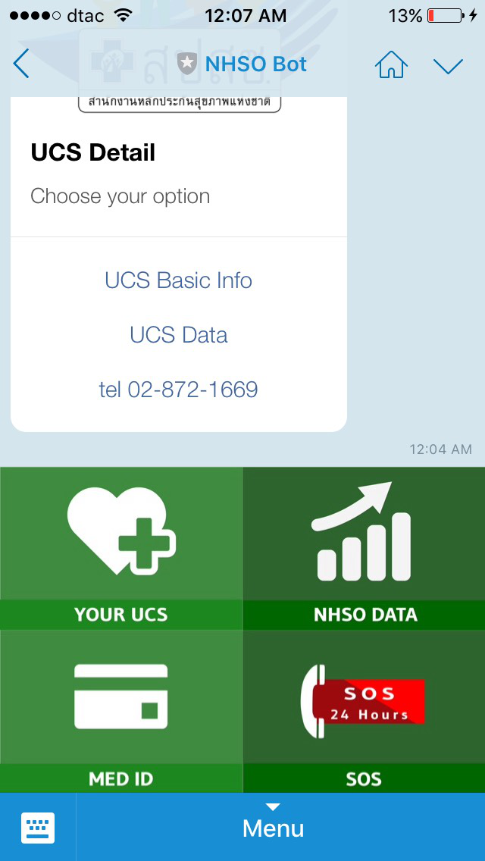
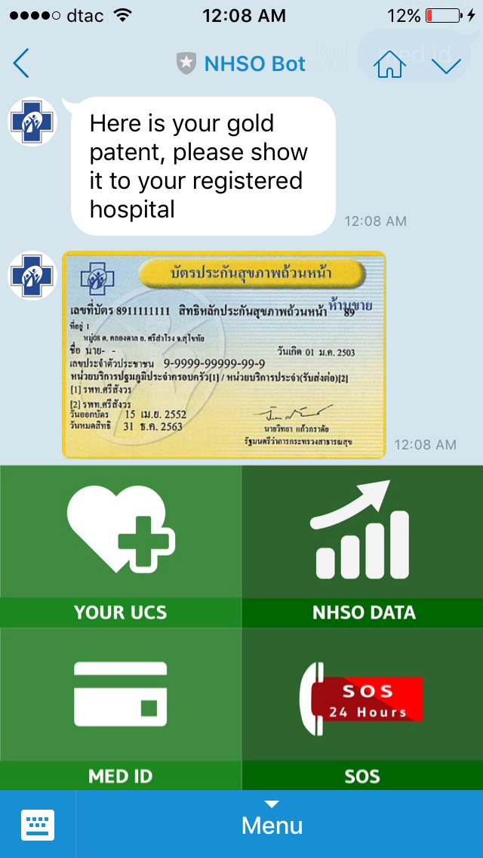
Notes:
Technical Explanation : Create data visualization by collecting and arrangement from raw data

Slide 11



TEAM -
Chonlarnatt Poonchattakarn
Business Specialist & Developer
Ploypitcha Boontavipitak
Sales & Marketing
Anon Chatwuthikrai
E-Commerce & Digital
Business Specialist
5 yrs of marketing experience from top global FMCG companies (L’Oreal, Henkel, etc.)
Founder of PetInsure
Co-Founder of Chatbot Thailand
- Business owner in e-commerce
sector - 5 yrs experience in digital marketing - 4 yrs system consultant - Technology savvy with business
thinking
Serial entrepreneurs in SMEs & Startups 10 yrs exp.
5 yrs exp. as full stack developer
Founder of Financial Broker in New Zealand
Founder of Chatbot Thailand
Notes:
Our team contains 3 specialists for data scientist and chatbot development.

Slide 12
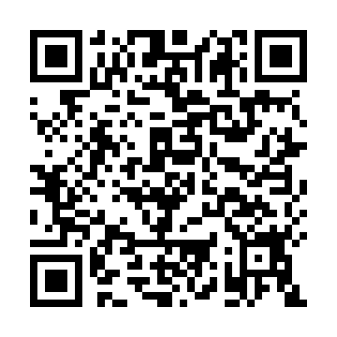
THANKS!
Let’s us make transparency in the national healthcare system
Any questions?
You can find me at
Line Bot : @jxo6629s
Dashboard URL:
https://goo.gl/q2AKss
Notes:
Let’s us make transparency in the national healthcare system.

